Slide 1

LatentView Analytics Proposal for Unilever Project Pinpoint
March 2020

Slide 2
Agenda
1
Business Context
2
Project Roadmap
3
Solution Overview & Data Considerations
4
Sample Platform Illustrations
5
Project Timelines, Pricing & Engagement Model
6
Case Studies
7
Appendix

Slide 3
Business Context

Slide 4

Project Pinpoint - Business Context & Objectives
Context
Unilever has close to 3 million ice cream cabinets, globally placed in a variety of locations including small independent retailers & other outlets
Currently the approach for cabinet placements is largely “Hunters” local knowledge with the help of a survey questionnaire to mapping success factors like points of interest like residential areas, parks etc. with local demand & product performance
Challenges with current approach is, it is not data driven & has a churn rate of 30-40% (around 800k cabinets are moved every year) due to suboptimal performance
Objectives
Main objective of the project is to optimize cabinet placements by multiple stages as given below:
Use Internal Data to map existing cabinet locations & success factors dynamically over time
Build recommendation engines to identify & map high potential stores / outlets
Use External data to identify purchase drivers for sales performance at an outlet level & also to identify prospective outlets
Build & Optimize Location Intelligence platform to enable hunters to make use of automated recommendations

Slide 5
Project Roadmap

Slide 6




Project Pinpoint – Platform Overview
LatentView’s proposed Location Pinpoint platform has a foundation Visualization layer and 4 Key modules to drive insights:
Benchmarking & Dashboarding
Drivers of Success Analysis
Outlet Recommendation
Dynamic Automation
Visualize Cabinet locations, Sales to Map & Benchmark across outlets
Analyze Drivers of Success
for Cabinet Performance
using Internal & external data
Look Alike Model using drivers of success applied on potential locations to propose to New Outlet Opportunities
Automated pipeline to generate Optimized Recommendations for the “hunters”
DATA GATHERING, VISUALIZATION & REPORTING
A robust framework for data gathering, visualization & reporting metrics, to view cabinet performances across Outlet categories
EXTERNAL + INTERNAL DATASETS
External data sources to augment Unilever internal data with granular location, demographic and competitor data

Slide 7

Project Pinpoint - Platform Roadmap
LatentView proposes a 3 phased approach involving i) Initial Business & Data Understanding followed by ii) An Agile Development model to build the location intelligence MVP followed by iii) Enterprising & Scaling up the solution for all markets
Benchmarking & Dashboarding
Outlet Recommendation
Business Understanding
Internal Data Understanding
Global Expansion
External Data
Drivers of Success Analysis
Look-Alike Modelling
Dynamic Automation
Validate Internal data volume, format & availability
Understand technology stack & preferences
Align on external data sources & cost
Business discussion to define performance measurement KPIs
Interview with SME’s
Benchmarking – Map cabinet locations & performance KPIs & build dashboards to benchmark across outlets
External data – Extract & translate external data & integrate with internal data
Drivers of Success Analysis Define & map success factors with costs to measure cabinet performance
Look-Alike Modelling
Identify & sort cabinets / outlets by performance KPIs
Build look-alike model based on outlet specific data, contextual external factors, cabinet performance, transfer costs & sales
Optimize
Optimize outlet suggestions based on costs (capex), space etc.
Automate
User interface to drive automated suggestions to hunters & take in hunter feedback
Global Expansion
Identifying specific global markets for product expansion
Scale pilot to global markets by using internal data from local markets & external data from region-based points of interest
Data Validation
Business Review
Algorithm Testing
Roadmap Planning
Data Discovery Phase
Pilot Phase – Turkey Market
Roadmap
2 Weeks
4-6 Weeks
7-8 Weeks
4 - 6 Months
Note
1. Timelines provided above are indicative & will be decided in collaboration with Unilever stakeholders at the end of data discovery phase
2. External Data Sources – For the purpose of timelines, we have assumed that we would use 8-10 external data sources to extract necessary data

Slide 8
Solution Overview & Data Considerations

Slide 9
Data Considerations
LatentView proposes to integrate a wide range of variables from variety of data sources listed below. These are indicative & prioritized in collaboration with Unilever in the initial 2 weeks (discovery phase) based on Feasibility, Applicability, Complexity & Cost.
Unilever ’s Internal Data
(LatentView will work with Unilever Internal IT teams to extract & use internal data)
Cabinet Data:
- Cost of Installation / Relocation / Maintenance
- Competitor Information / Product Assortment
Location Data:
- Cabinet location & store performance
- Promotions, Marketing efforts – In Outlets
- Coverage, Area of Outlets
- Website engagement info
Sales & Cost Data:
- Setup cost / ROI for Outlet
- Weekly/Monthly - Sales Information
Agent / Hunter Data:
- Agent feedback about store
- Product assortment feedback
Syndicated Data (Paid)*
(LatentView will source the syndicated data and would charge Unilever on actuals)
Reach & Engagement:
- Socio-Demographic factors
- Footfalls by establishment (Ex: Competitor, POI)
- Avg. Frequency of Visits, Footfall probability
- Psychographic factors
GIS Data:
- Outlet locations
- Outlet categories & Footfalls
- Outlet Reviews & Ratings
- Distance matrix for point of interests data (prospects & competitor info
- Visitor Journey – Other outlets visited etc.
Seasonality Data – Weather:
- Temperature, Wind, Humidity, Precipitation, Cloud, Frost/dew/snow indicators
External (Public ) Data
(LatentView will develop custom built data aggregator to source publicly available data)
Point of Interest Data:
- Populated Hotspots & Footfalls
- Establishment categories & location
- Education, Healthcare, Tourism, Footfalls
Census Data – Zip / Pin Code:
- # Population, Age, Distribution
- #Households, # Average Households Size
- Family Status & Size
Safety & Food Security Data:
- Pin code level safety factors
- Food security data
Product Reviews & Sentiment:
- Review sentiment
- Brand mentions
Based on Internal data availability & volume, LatentView would collaborate with Unilever to categorize usability of internal data & databases to store internal data for the pinpoint analytics platform
GIS & Reach: RevealMobile (Cost: $4k -$5k)
Weather & Seasonality: Meteomatics
GIS + Zip Level Demographics Visualization: ESRI ($2.5k for 5 users, can go upto $10k)
The following sources provides freely available demographic, point of interest data variables:
Humanitarian Data Exchange / Data.gov
World Bank etc.
*Indicative cost for external (Syndicated) data will be charged at actuals but an indicative price provided above

Slide 10




Solution Architecture Overview
Unilever Data
LOCATION PINPOINT PLATFORM
Store Data
Store Name
Store ID
Store size
Cabinet ID
No. of Employees
GPS Data
Preprocessing and Storage
ML/AI Services
Visualization
USERS
Product Details
Transformation
Module
MAP EXISTING ICE CREAM CABINETS
Marketing
& Promotions
efforts
Sale Rep Survey responses
Sales Team
Sales Performance
Sales Data
Outlet Drilldown
Region Drilldown
Footfall
Sales Leadership
Syndicated Data
Conversion
Popular products
GIS Data (Location)
Weather
Temperature
Humidity etc
Location
Module
DRIVER IDENTIFICATION FRAMEWORK
Key Drivers
Competitor
Information
Consumer
Segments
Centralized
Data Storage
Regional Heads
Public Data
OUTLET
SELECTION
MODULE
High Potential Areas
High Potential Stores/Outlet
*NLP
Module
Demographics
Population
Age etc.
Location Categories
Events/
Functions
Tracker
Product Reviews/
Ratings
AUTOMATED RECOMMENDATION ENGINE
SECURITY MANAGEMENT, USER AND ROLE MANAGEMENT**
* NLP Module would be used for categorizing product reviews / ratings (or) categorizing hunter feedback in surveys
** The above framework is generic & it can be implemented in On premise or any of Unilever’s cloud services (like MS Azure Data Factory or AWS stack)

Slide 11
Sample workflow - Driver Identification Framework
Unilever Data
Syndicated Data
Public Data
Store Data
Store Name
Store ID
Store size
Cabinet ID
No. of Employees
GPS Data
GIS Data (Location)
Weather
Temperature
Humidity etc
Demographics
Population
Age etc.
Location Categories
Product Details
Competitor
Information
Consumer
Segments
Events/
Functions
Tracker
Product Reviews/
Ratings
Marketing
& Promotions
efforts
Sale Rep Survey responses
Sales Data
Cabinet ID | Store ID | City | Temperature | Humidity | Population | Footfall | Events | Promotions effort | Average Rating | Popular Brand | Proximity to Imp places | Proximity to Competitor | Weekly/ Monthly Sales
1234 | 4321 | Istanbul | 20 | 75 | 50000 | 500 | Yes | 100 | 3.5 | Cornetto | 0.5 | 0.2 | 1000
1234 | 4321 | Istanbul | 18 | 80 | 50000 | 200 | No | 0 | 3.3 | Magnum | 1 | 0.1 | 650
5678 | 8765 | Ankara | 16 | 70 | 40000 | 300 | Yes | 150 | 4 | Cornetto | 0.3 | 0.3 | 800
… | … | … | … | … | … | … | … | … | … | … | … | … | …
… | … | … | … | … | … | … | … | … | … | … | … | … | …
Parameters | Importance Score
Events | 0.85
Footfall | 0.82
Proximity to Imp places | 0.81
Population | 0.8
Temperature | 0.78
Proximity to Competitor | 0.77
Promotions effort | 0.75
Average Ratings | 0.65
Humidity | 0.62
Popular Brand | 0.4
Feature Importance Estimation using a Regression / Classification model

Slide 12
Sample Platform Illustrations
(Regional / Zip Code Overview)

Slide 13


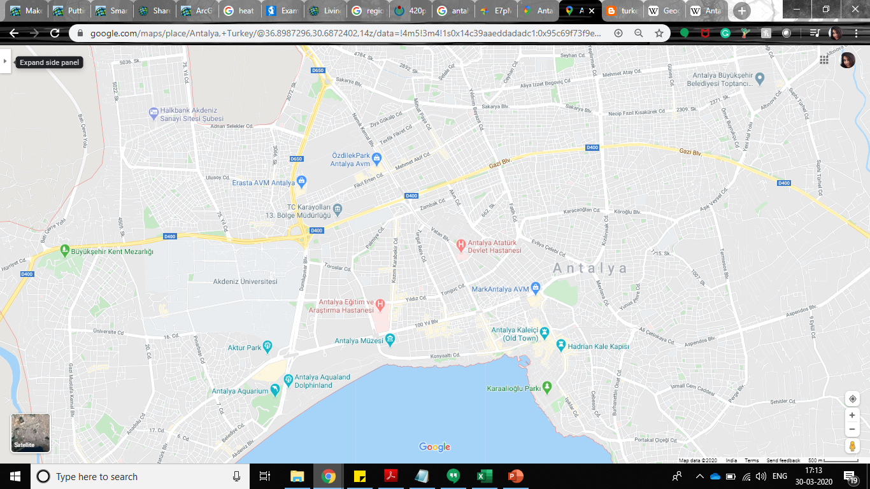
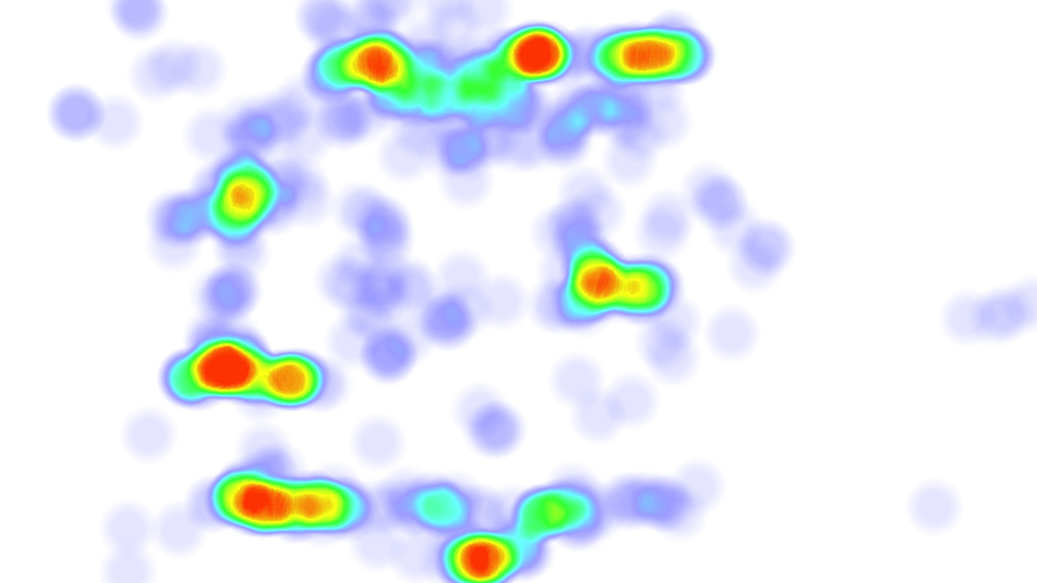
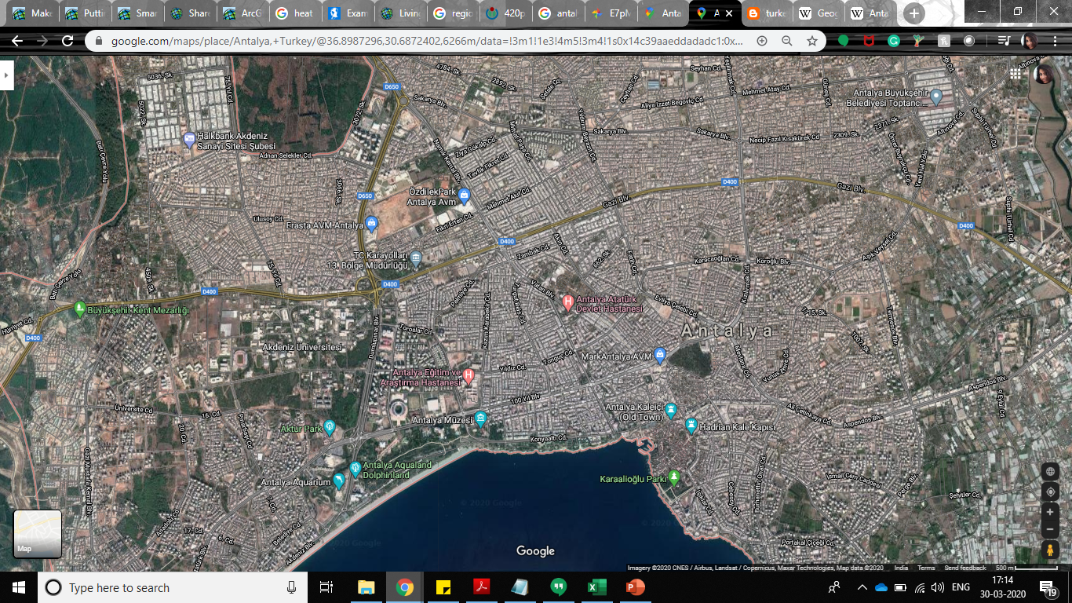

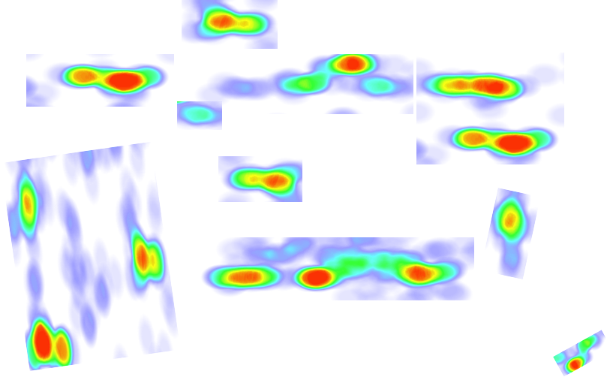

Sample Illustration - Regional level outlook on Outlets, Brands
Overview / Regional Overview
Outlet Overview
Drivers of Success
Regional – Unilever Outlets Performance KPIs
Regional - Unilever Outlets Deep Dive
Quarter
Q2 - 2018
Total Outlets: 10.5k
Outlet Details
Outlet Performance
Competitor Outlets
Turkey
Black 8%
Zip Code | Outlet ID | Name | Category | Area (sq. ft) | Cabinet Model
07112 | 231 | Matiz | Super Market | 7000 | Display
07190 | 232 | Meyhanesi | Restaurant | 2500 | Freezer
07050 | 233 | Bademalti | Cafe | 1543 | Glass Top
07310 | 234 | Vanilla | Parlour | 762 | Open Door
Country
Total Revenue: $590m
Revenue / Outlet: $57k
Region
Mediterranean
Customers: 13m
Units Sold: 34m
Province
Antalya
Total Cost: $400m
Cost / Outlet: $38k
Regional - Unilever Outlets Geographical View
Regional – Opportunities Heat Map
Heat Map represents untapped sales potential (i.e.) regions where unilever cabinets are not present but has high footfalls

Slide 14
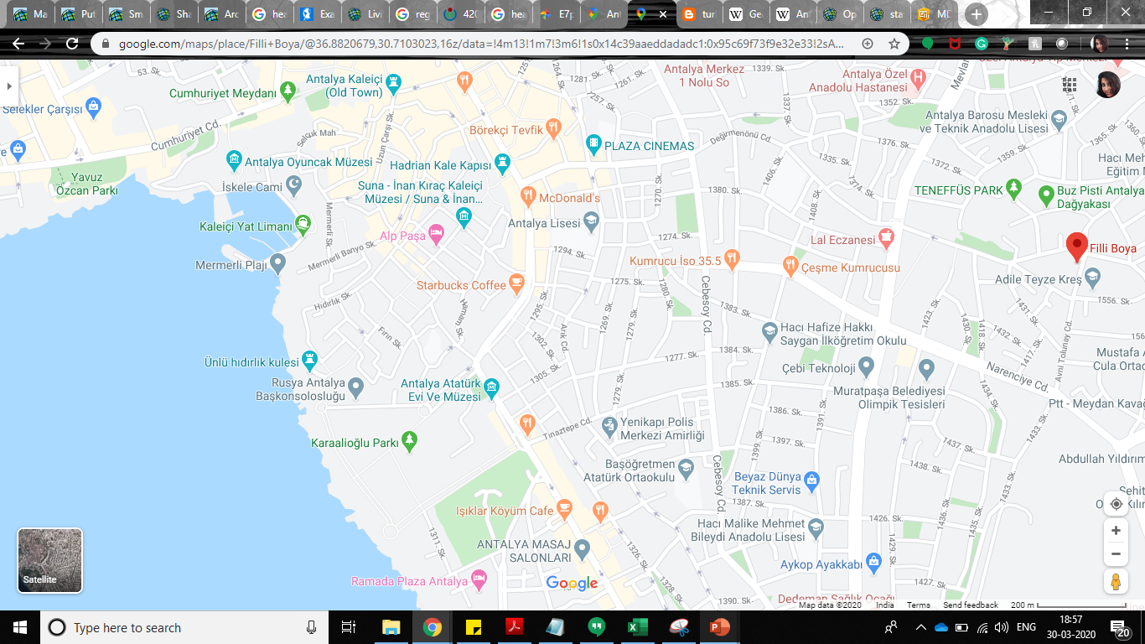


Sample Illustration – Zip Code level outlook on Outlets, Brands
Overview / Regional Overview
Outlet Overview
Drivers of Success
Quarter
Q2 - 2018
Turkey
Outlet Recommendations – Geographical View
Country
Region
Mediterranean
Province
Antalya
Opportunity
Outlet Name: Plaza
Zip Code: 07112
Success Factor: Mall
Safety Flag: Y
Transfer Costs: $11k
Potential Sales: $66k
Growth expected: $55k
Unilever Outlet Performance KPIs
Outlet Name: Matiz
Outlet Category: Supermarket
Outlet ID: 231
Total Customers: 450
Revenue: $20k
Success factors: None
Outlet Name
Outlet Name: Matiz
Zip Code: 07112
Success Factor: None
Potential Sales: $20k
QoQ $ Growth: -5%
Total Customers: 450
QoQ $ growth: -5%
QoQ Customer Growth: -10%
Black 8%
Outlet Recommendations
Demographic
Sales Potential
Competitors
Review
Zip Code | Success Factors | Outlet Name | Safety Flag | Transfer Costs | Potential Sales – Transfer Costs
07112 | Park | Café Hub | Y | $5k | $35k
07112 | School | Cebesoy | Y | $8k | $32k
07112 | Mall | Plaza | Y | $11k | $55k
07114 | Park | Lisesi | N | $12k | $30k
07114 | Restaurant | Koyum | Y | $5k | $40k

Slide 15
Project Timelines, Pricing & Engagement Model

Slide 16
Project Pinpoint – Project Plan & Pricing
Data Validation
Business Review
Algorithm Check
Stage | Activity | W1 | W2 | W3 | W4 | W5 | W6 | W7 | W8 | W9 | W10 | W11 | W12 | W13 | W14 | W15
Benchmarking & Dashboarding | Data Understanding and preparation
 | Building data marts using Internal data
 | Develop Dashboards (ESRI – react.js) using location & performance data
Drivers of Success Analysis | Evaluation & Integration of Public data sources (Demographics & Location)
 | Evaluation & Integration of Syndicated data sources (GIS & Engagement)
 | Define Cabinet Performance KPIs
 | Develop dashboards for external data & newer modules
Outlet Recommendations | Models to classify & categorize outlets
 | Look Alike models to suggest store outlets
 | Scenario simulators to visualize RoI on relocation scenarios
Optimize & Automate | Outlet Optimization web UI for hunters
 | Optimizer for look alike models & scenario simulator
Roadmap Planning
External (Syndicated) data / infrastructure costs are not included in the above price and will be charged at actuals
Assumptions: Max. 4-5 dashboards to be developed incorporating information from all the stages

Slide 17
Pricing, Assumptions & Prerequisites.
Pricing:
The pricing for this initial project will be £120,000.00 and will be executed in ~4 months.
The price is exclusive of VAT & Taxes, if any. LatentView will take care of all employee related & travel related costs. The price does not include any External (Syndicated) Data, Infrastructure & Software licenses cost (Expected to be managed by Unilever or will be in Actuals)
Assumptions:
Project requires single PoC/Program Manager from client for business, technical & program guidance.
LatentView will have 2 members working onsite on first & last 2 weeks of engagement
Weekly communication cadence will be set-up between Unilever stakeholders and LV team members.
Prerequisites to start the project:
Paperwork - Non - Disclosure Agreemet & Statement of work signed by both the parties.
Time to start - A 2 - 3 Week lead time from the date of confirmation to plan & kick start the project.
Technology - Access to the Unilever Network (~VPN), Data sources, systems, data dictionary & documentation
Functional: Timely inputs & feedback from stakeholders during the 4-month period.

Slide 18










Project Model - Typical Path to Kick Off
Project Engagements have a critical path to kick off & achieving steady state and the lead times need to be factored in timeline planning.
Executive Presentation
Paperwork & Data Discovery Phase
OnBoarding
Milestones & Business Reviews
Scoping Discussion
Vendor Decision & Budget Planning
Infrastructure & Access Setup
Project Closure & Roadmap Planning
Project Start
Scoping & Discussions
~May 01
Kick - Off
Roadmap Planning

Slide 19







Project Pin Point - Assumptions & Responsibilities
Requirements
Responsibilities
Point of Contact (POC)
The designated Point of Contact (POC) would help in coordinating Knowledge Transfer sessions, access to business teams for business understanding and data queries
Review of deliverables, project status tracking and resolving queries / issues
Availability of SME’s
Access to Unilever’s SMEs would be important for the LatentView team to familiarize itself with the business and data environment, understanding of the systems and processes that Unilever follows
Timeline Assumptions
Access to Unilever’s data will be provided within the first week of project kick-off and most data queries resolved before the end of week 2 of the project to complete work package 1
Documentation: Data Dictionary / DB
Unilever would provide LatentView team with the documentation on the data sources and data dictionary which would help in aggregation of the requisite data
Requisite Access: DB’s / Systems
Support from Unilever team to help the LatentView team setup the requisite infrastructure from Chennai office
Quick setup of ID’s, requisite access and permissions to the team members
Setup Virtual Machine access / Staging environment for the offshore team
Infrastructure
Technology Infrastructure to store the collated data, model and computation algorithms will be provided by Unilever
Software and Data Source Licenses
Access to tool licenses will be provided by Unilever or LatentView can procure them for Unilever and be reimbursed on actuals

Slide 20








Project Pinpoint - Proposed Engagement Structure
STEERING COMMITTEE
Roles & Responsibilities
Target & Track Business Priorities using Monthly Business Review meetings (MBR’s) & Quarterly Business Review meetings (QBR)
Acts as an escalation point to get things done faster
PROJECT SPONSORS
SENIOR MANAGEMENT
Senior Management
Unilever
LatentView
Project Team
Primary interface with Client business leaders
Work with Client team to identify and prioritize analytics opportunities
Ensures seamless workflow management, quality control and delivery schedule management
Project Manager
Unilever Program
Manager
Project Manager
Project Pinpoint
Dedicated analyst team with experience in various analytics projects
Expertise in techniques such as data analysis, engineering, visualization, modelling, etc and analytics tools such as QlikView, SQL, Python, R, SPSS, SAS, etc.
Core Analyst Team
Foundry
Team
Analytics /
IT Team
Turkey
Team
Data Analysts

Slide 21
Case Studies

Slide 22








To Integrate Data & Identify profitable locations for cooler placement
The Problem: Global Beverage Company wanted to build a single source of truth to optimize product placements & understand sales drivers at retail outlets
The “Before” State
LatentView Solution
The “After” State
Disparate data sources across databases
Product placements driven by human judgement & individual data sources
No data driven approach for measuring profitability of existing model
To integrate data & create a data mart
To build segmentation models to identify potential location for coolers
To build models for predictive maintenance of coolers & Sales forecasting
Automated real-time business intelligence application to view sales performance & predict locations to place coolers
Scenario analysis map to generate scenarios & measure profitability
Data Sources
Analytics Data Mart
Segmentation & Clustering
Cooler Data
Cost of Installation / Maintenance / Downtime
Competitor information
Product assortment
Location – Cooler & Store - Performance
Clustering Algorithm
Customer Segments
Data Integration Layer
Distributor Engagement Data
Coaching Date / Time Spent
Sales Rep coached
Distributor ID
Group - A
Data Quality / Governance
Profiling/Monitoring
Distributor Sales Data
Transaction / Product
Location / Region
Promotion dollars
Data Cleaning
K-Means Clustering
Group - B
Data Consolidation
Decision Trees
Group - C
Store Data
Agent Feedback about store
Product assortment feedback

Slide 23
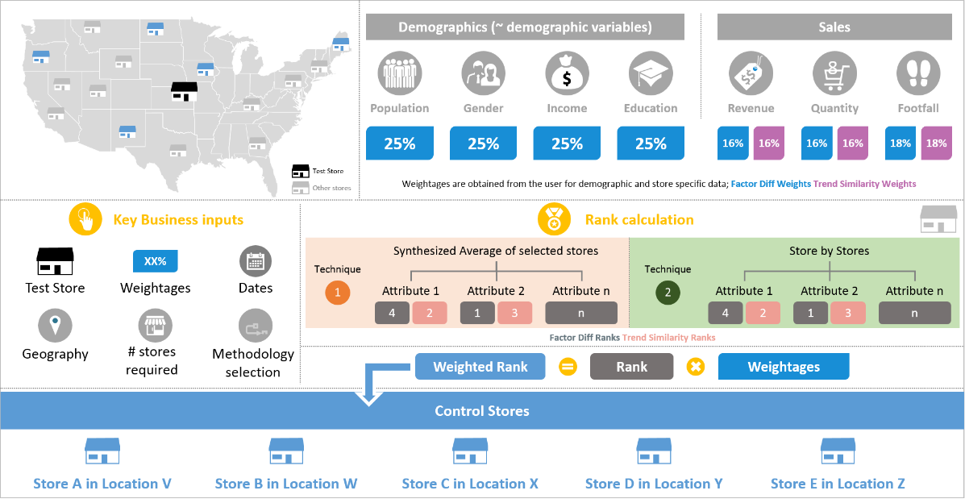
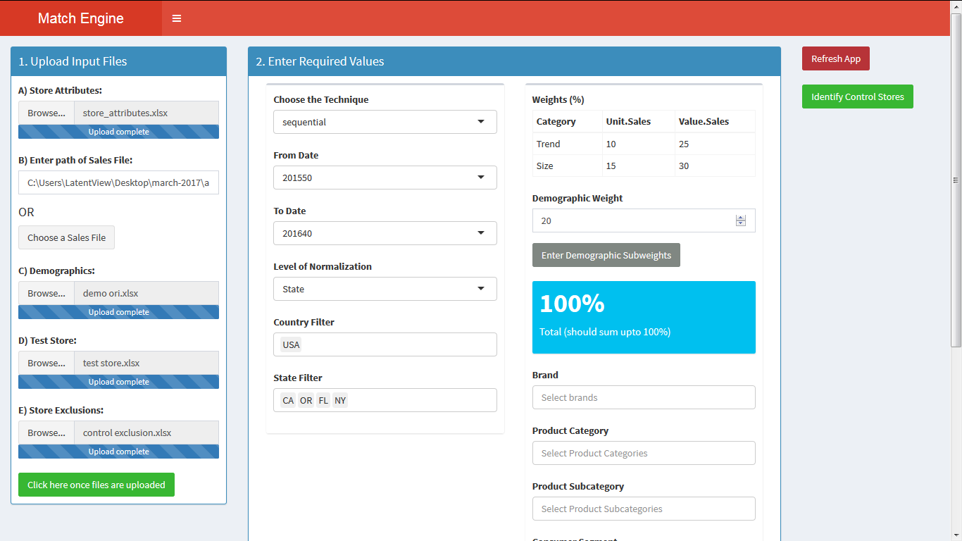
Store Identification for Campaigns using MatchView
Leading Apparel company
The Problem: In the retail business, assessing the success of marketing campaigns using the right set of stores is critical to ensuring in making the investments into the right set of campaigns
The “Before” State
LatentView Solution
The “After” State
Lack of systematic process and the time spent for identifying control stores was rendering the assessment of marketing campaigns difficult with several inconclusive results
Built a retail store match engine using a weighted factor difference and trend similarity algorithm to rank control stores and analyze campaign performance using ANCOVA
Reduced campaign turnaround time by over 90% and increased campaign success conclusiveness influencing $284 MN. of marketing spend to right campaigns
Control Store Identification Process

Slide 24





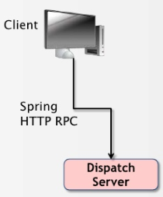







Intelligence route planning to optimize truck route & warehouse inventory
The Problem: Global Food Distribution Company wanted to use GPS Sensor data of trucks & product inventory data to build a web solution for an intelligent route planning & improve time to delivery
The “Before” State
LatentView Solution
The “After” State
Disparate data sources across databases
Current route planning model based on TSM problem & doesn’t use sensor data
Cross docking not possible due to unavailability of live data tracking
Integrate sensor data, maps data with inventory, route & truck data for
Intelligent route planning
Enable cross docking
Improve time to delivery
Enterprise level truck optimization & route planning model to track & plan real time in a web app
Accuracy measurement driven using new set of KPIs (KGs / KMs, Time to delivery etc.)
Methodology
Platform Solution
Data Collection
Data Processing & Data Lake Creation
UI Layer
Sensor information Collation
Custom Application
Analytics
Relational Data Store
(Ex: AWS Redshift)
Customer UI platform to display charts , route, truck location on Maps and inventory metrics
GPS sensor data:
Location coordinates
Load information
Start time
Data Connection API provides the link pulling data on real time basis
Data Lake
(Ex: S3)
API
Sensor data transmitted through GPS installed on trucks
Index & Query
(Ex: Elasticsearch)
Answer Key Questions
Where are the trucks
How much load carried
Estimated arrival time
Inventory data:
SKU stocking
Orders / Truck
Load & delivery
Location - Supplier/cust.
Google Maps API
Combined with inventory information flowing through Supply chain ERP system
Query, Modify, Export Info into application
REST services
Visual web tool (Plottable , D3 JS)
Data Lake on AWS
Blueprint, Django & REST

Slide 25
Thank you
Mahadevan.Balakrishnan@latentview.com
Ph: +91 9840683606

Slide 26
Appendix

Slide 27





External Data Providers – Turkey & Global Markets
Data Provider
GIS for Establishments Location data
GIS & POI data
GIS & Reach/Engagement data
Weather & External Factors
Location Coordinates, Address
Presence of competitor, socio-demographic data, psychographic data, foot traffic probability
Location Coordinates, Address, Outlet Category
Categorizes Location type, Map your POI with the database
# Footfalls, Average Frequency of Visits, # Lost customers, # factors (residence, park, school, hospital)
Location Coordinates, Address, ZIP
Establishment Reviews & Ratings
Temperature, Wind, Humidity, Precipitation, Cloud, Frost/dew/snow indicators
Location Coordinates, Address
Categorizes Location type, Map Visitor Journey
Market share of brand in footfalls, Brand v Competitor footfalls over time
Notes:
Pricing for Syndicated Data
ESRI – GIS data, Demographics & Consumer Behavior Data - $2500 for 5 users, 2500 credits. Based on usage, no. of credits and price can increase to up to $10,000

Slide 28


Visualization Tool – Decision Matrix
Subscription Levels and Pricing
Three Options that we can opt for, but price is not mentioned anywhere
ArcGIS Online (Desktop Version is also there)
ArcGIS Pro (Basic, Standard and Advanced)
ArcGIS Enterprise (Basic – 5 people and Advanced – 50 people)
In total 4 Options
1. New Customer – Single User (US$ 695)
Remote Desktop or Concurrent User (US$ 995/user)
2. Existing Customer – Single User (US$ 395)
Remote Desktop or Concurrent User (US$ 695/user)
Input
Input from computer, web, cloud drive and added apps in a wide variety from CSV, Excel, PPT, PDF, KML, GeoJSN, shapefiles, annotation, CAD, Raster, Imagery , geodatabase, adding URL or register APP.
We can import and open over 50 file types and more than 100 GIS and CAD formats including, image (raster/vector), database/table/spreadsheet, multimedia, 3D, image servers.
Output
We can share items, maps, scenes, apps, presentations, groups, link to items, we can join and use group, create and own group, collaborate between internal or multiple enterprise portal
Export option is available for most of the file types but not all.
World data includes Cities and Capitals, Countries (Charged per country), Gazetteer, Important Latitude, Provinces , 5 and 10 Degree Grid and 10 Degree Area Grid , business data census geography, political boundaries
Data Available
ArcGIS Live Atlas for the World that includes imagery, basemaps, demographics and lifestyle, landscape, boundaries and places, transportation, earth observations, urban systems, oceans
Interactive 2D and 3D map with street level granularity, location, routes, geography, smart maps like heat, color size, point, time, arcade expression, clustering, relationship, trends, predominance, Map styles for customization, and real-time live maps, Curtography
Geography, aerial/satellite, postal/zip code, routes, store, territories, relationship, rings, Hot Spots and Heat Mapping, Surface Analysis, Areas of Influence, desire Lines, Trade Areas and Site Location
Map features
Analysis
Tools available for real-time, big-data and deep image analysis, spatial analysis. Automation tools for geoprocessing with Python built-in
Tools available for analysis with the available data along with the input data.
Demo and Free Trial
Free trial for 21 days with specific features
Free trial available for New Customers

